Slide 1
Gravity Demonstration
By lunar learners

Slide 2
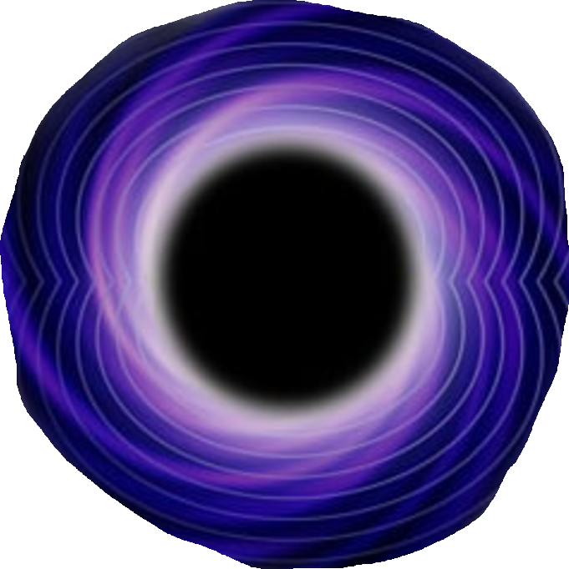
About our app
We have designed our app, keeping in mind about the topic gravity, and the first image which came to our mind was the Black Hole.
A Black-Hole is the Gravity Monster. It engulfs anything that comes close to its event horizon.
And Our game is similar to it. Our black hole also swallows planets and objects that comes in the event horizon

Slide 3
PyGame
PyGame is the Library in Python, that helped us to complete the game within a short period of time and with a better experience of run time games.

Slide 4
What Our App Does
Our App or the Game we developed demonstrates the power of gravitational pull of black hole. It shows that a Black Hole is a Monster, and it can Swallow anything comes in its path.
There is a Black-Hole in our app, that the users can Move using Up Down Left Right arrows of the keyboard.
There will be planets coming on the screen and the black hole will swallow them as soon as the event horizon of the Black Hole touches them.
And There is no Limits to the swallowing density or the size of the black hole. It will grow larger and larger as it continues swallowing objects.

Slide 5
ABOUT THE TEAM
ARPAN CHATTERJEE (TEAM LEADER): Bachelor of Science in Computer Science and Data Analytics from IIT Patna & Bachelor of Technology in Electronics and Communication Engineering from AEC, Asansol
SUBHADEEP MURMU: Bachelor of Technology in Aerospace Engineering from IIT Kharagpur
YOUSHODEEP ACHARYA: Bachelor of Technology in Computer Science Engineering from NSHM Knowledge Campus, Durgapur

